Slide 1
Control Of Upper Body Exoskeleton For Load Carrying Activities
Research Update by:
Vasumathi M D,
Ph.D. Research scholar,
CAIR-DRDO & NITT.
Under the Guidance of :
Dr. Shubhashisa Sahoo, Scientist-F, CAIR, DRDO.
Dr. M. Umapathy, Professor, ICE, NITT.

Slide 2
Introduction
Exoskeleton is an external wearable device.
It is an electro-mechanical system that combines various technologies to enable the limb movement of the users with greater strength and support.
Exoskeleton always operates in parallel with the human it provides support to.
Applications:
Used in Military, Medicine and Industrial applications by providing assistance to workers in enhancing their job and accelerate the recovery process in rehabilitation purpose.

Slide 3
Advantages and Dis-advantages
Powered exoskeletons can improve the quality of life of individuals who have lost the use of their legs by enabling system-assisted walking.
Disadvantages:
The exoskeleton can’t stretch or expand.
Humans exhibit a wide range of physical size differences in both skeletal bone lengths and limb, so exoskeletons must either be adaptable or fitted to individual users.
The power supply requires frequent replacement or recharging and may risk an explosion due to the thermal runaway.

Slide 4
Modeling And Control
The objective of this research is to model and control the upper body exoskeleton for load carrying activity.
A general block diagram of the overall system can be shown as follows,
Fig.1. Block diagram of a closed loop control for exoskeleton system
Actuator
Motor
(DC/EC)
Exoskeleton
system
Sensors
Controller

Slide 5
Scope of the Work
The different task to be done are,
Modeling an actuator.
Modeling an exoskeleton.
Development of controller.
Real time implementation.
Currently, the scope of work is to simulate an actuator model.

Slide 6
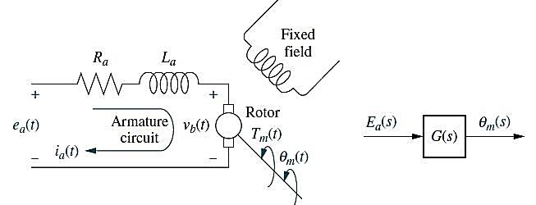
Mathematical Modeling of the Actuating System of Exoskeleton (DC Motor)
Fig.2(a) Equivalent circuit diagram of DC motor
Fig.2(b) Block diagram of DC motor

Slide 7
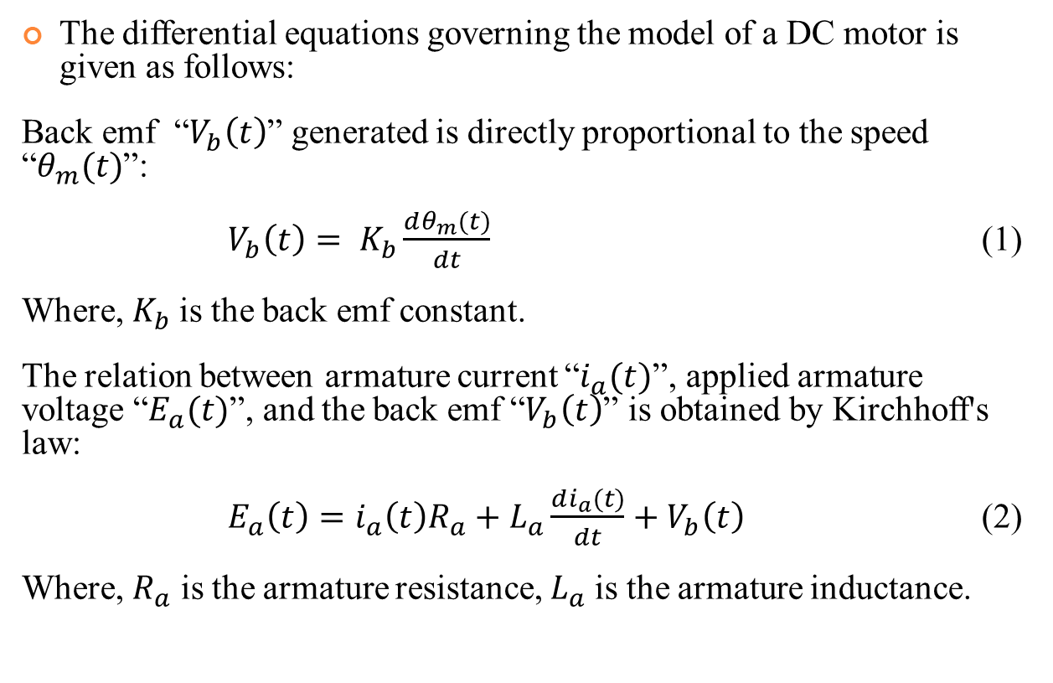
Modeling Equations
The differential equations governing the model of a DC motor is given as follows:
Back emf “$V_{b}\left(t\right)$” generated is directly proportional to the speed “$θ_{m}(t)$”:
$V_{b}\left(t\right)= K_{b}\frac{dθ_{m}(t)}{dt}$ (1)
Where, $K_{b}$is the back emf constant.
The relation between armature current “$i_{a}(t)$”, applied armature voltage “$E_{a}(t)$”, and the back emf “$V_{b}\left(t\right)$” is obtained by Kirchhoff's law:
$E_{a}\left(t\right)=i_{a}\left(t\right)R_{a}+L_{a}\frac{di_{a}(t)}{dt}+V_{b}\left(t\right)$ (2)
Where, $R_{a}$ is the armature resistance, $L_{a}$is the armature inductance.

Slide 8
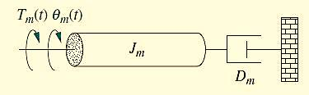
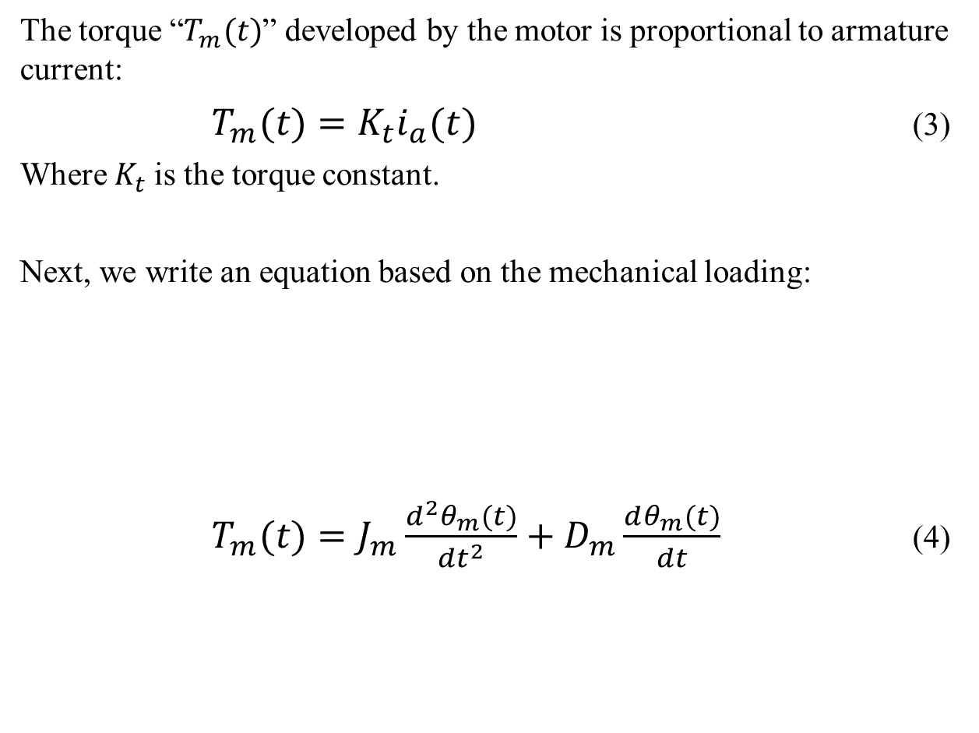
Modeling Equations Contd…
The torque “$T_{m}(t)$” developed by the motor is proportional to armature current:
$T_{m}(t)=K_{t}i_{a}(t)$ (3)
Where $K_{t}$is the torque constant.
Next, we write an equation based on the mechanical loading:
$T_{m}(t)=J_{m}\frac{d^{2}θ_{m}(t)}{{dt}^{2}}+D_{m}\frac{dθ_{m}(t)}{dt}$ (4)

Slide 9
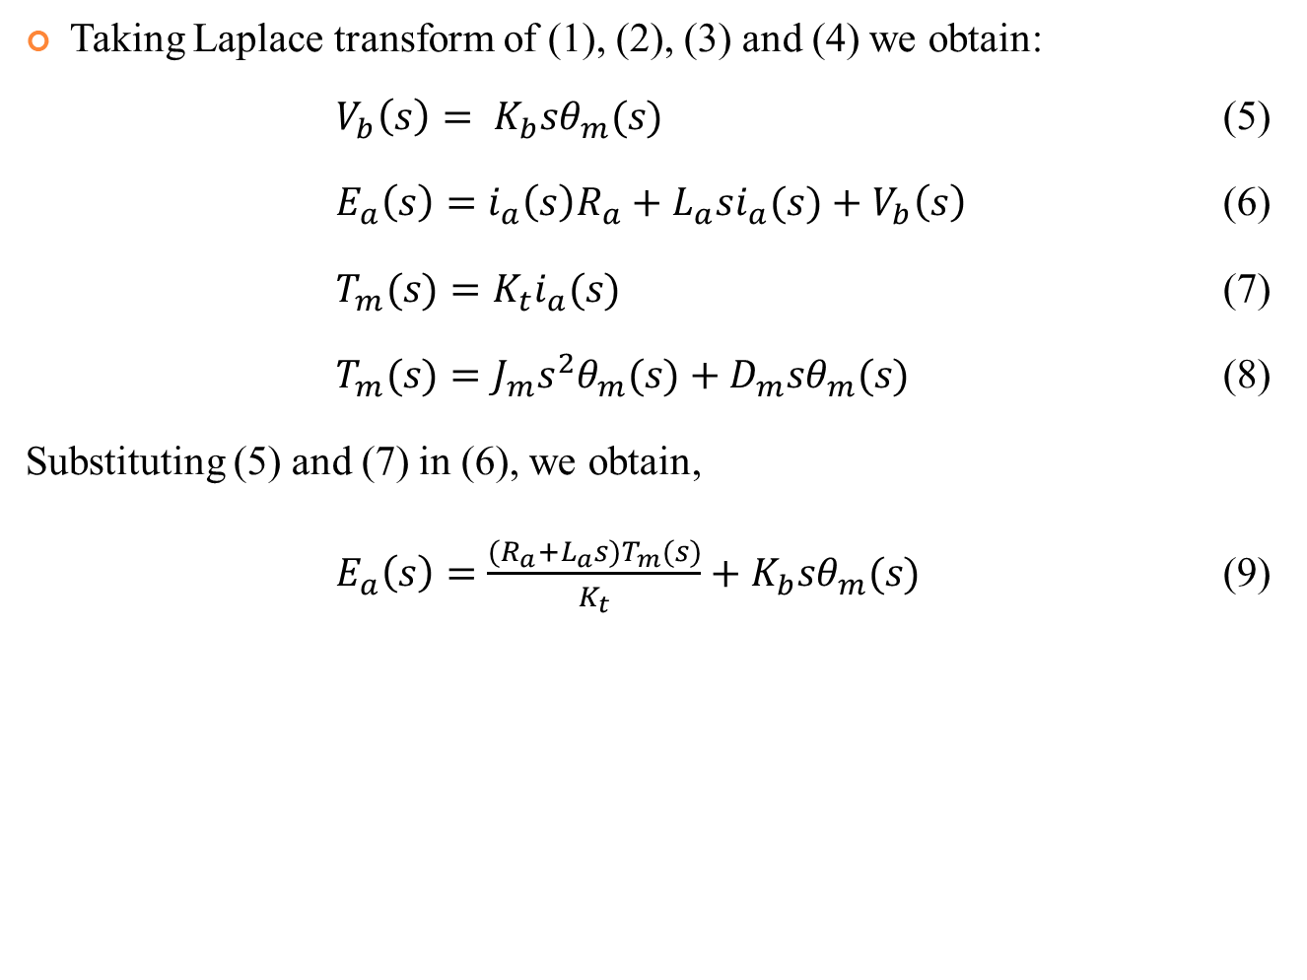
Modeling Equations Contd…
Taking Laplace transform of (1), (2), (3) and (4) we obtain:
$V_{b}\left(s\right)= K_{b}sθ_{m}(s)$ (5)
$E_{a}\left(s\right)=i_{a}\left(s\right)R_{a}+L_{a}si_{a}(s)+V_{b}\left(s\right)$ (6)
$T_{m}(s)=K_{t}i_{a}(s)$ (7)
$T_{m}(s)=J_{m}s^{2}θ_{m}(s)+D_{m}sθ_{m}(s)$ (8)
Substituting (5) and (7) in (6), we obtain,
$E_{a}\left(s\right)=\frac{(R_{a}+L_{a}s)T_{m}(s)}{K_{t}}+K_{b}sθ_{m}(s)$ (9)

Slide 10
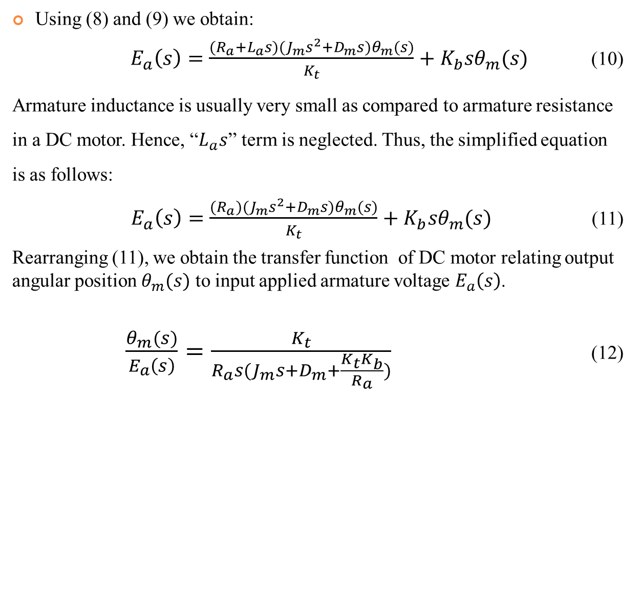
Modeling Equations Contd…
Using (8) and (9) we obtain:
$E_{a}\left(s\right)=\frac{(R_{a}+L_{a}s)(J_{m}s^{2}+D_{m}s)θ_{m}(s)}{K_{t}}+K_{b}sθ_{m}(s)$ (10)
Armature inductance is usually very small as compared to armature resistance in a DC motor. Hence, “$L_{a}s$” term is neglected. Thus, the simplified equation is as follows:
$E_{a}\left(s\right)=\frac{(R_{a})(J_{m}s^{2}+D_{m}s)θ_{m}(s)}{K_{t}}+K_{b}sθ_{m}(s)$ (11)
Rearranging (11), we obtain the transfer function of DC motor relating output angular position $θ_{m}(s)$ to input applied armature voltage $E_{a}\left(s\right)$.
$\frac{θ_{m}(s)}{E_{a}\left(s\right)}=\frac{K_{t}}{R_{a}s(J_{m}s+D_{m}+\frac{K_{t}K_{b}}{R_{a}})}$ (12)

Slide 11

Modeling Equations Contd…
Final transfer function is obtained by rearranging (12) as follows:
$\frac{θ_{m}(s)}{E_{a}\left(s\right)}=\frac{{K_{t}}/{R_{a}J_{m}}}{s[s+\frac{1}{J_{m}}\left(D_{m}+\frac{K_{t}K_{b}}{R_{a}}\right)]}$ (12)

Slide 12
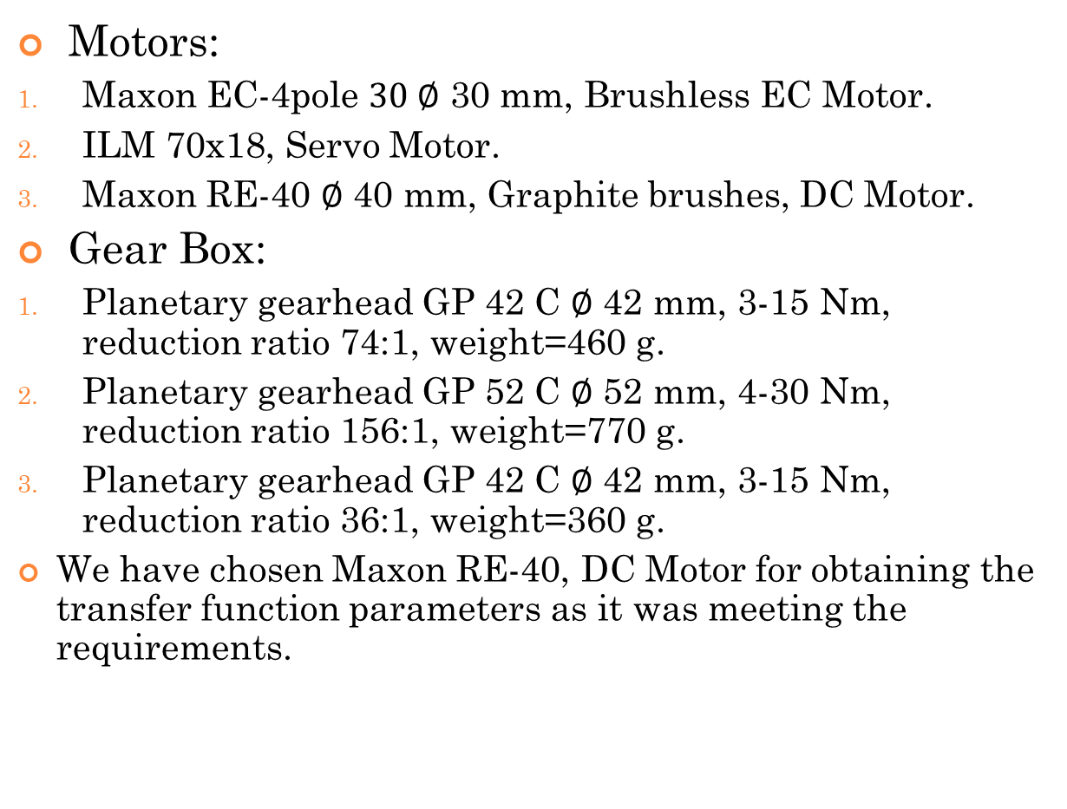
Selection Of Motors and Gear Box
Motors:
Maxon EC-4pole $30 ∅$ 30 mm, Brushless EC Motor.
ILM 70x18, Servo Motor.
Maxon RE-40 $∅$ 40 mm, Graphite brushes, DC Motor.
Gear Box:
Planetary gearhead GP 42 C $∅$ 42 mm, 3-15 Nm, reduction ratio 74:1, weight=460 g.
Planetary gearhead GP 52 C $∅$ 52 mm, 4-30 Nm, reduction ratio 156:1, weight=770 g.
Planetary gearhead GP 42 C $∅$ 42 mm, 3-15 Nm, reduction ratio 36:1, weight=360 g.
We have chosen Maxon RE-40, DC Motor for obtaining the transfer function parameters as it was meeting the requirements.

Slide 13
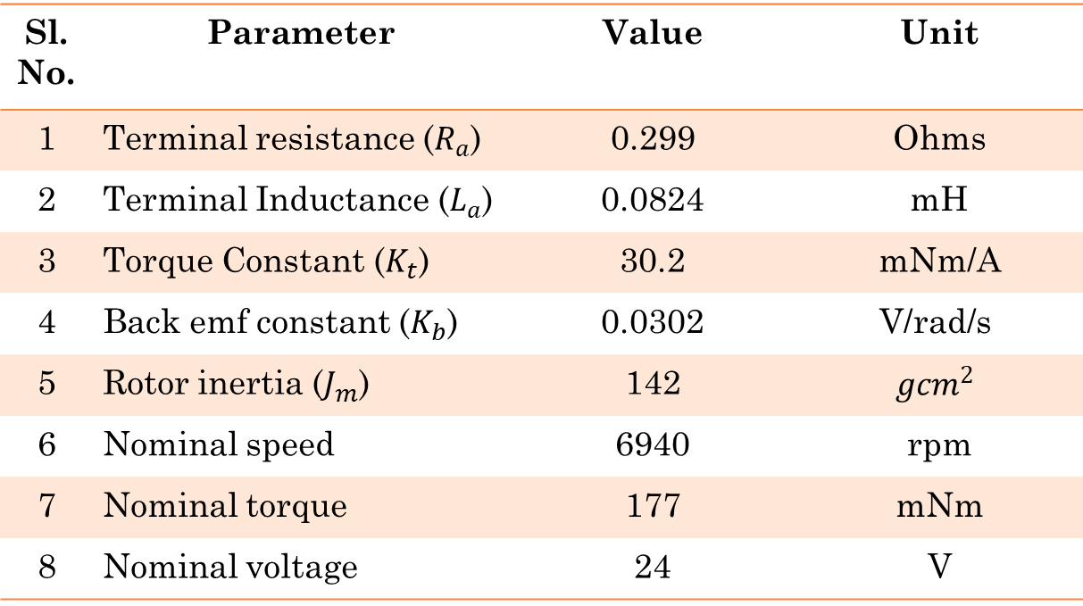
Parameters of Maxon RE-40 Motor
Sl. No. | Parameter | Value | Unit
1 | Terminal resistance ($R_{a}$) | 0.299 | Ohms
2 | Terminal Inductance ($L_{a}$) | 0.0824 | mH
3 | Torque Constant ($K_{t}$) | 30.2 | mNm/A
4 | Back emf constant ($K_{b}$) | 0.0302 | $$\text{V}\text{/}\text{rad}\text{/}\text{s}$$
5 | Rotor inertia ($J_{m}$) | 142 | $$g{cm}^{2}$$
6 | Nominal speed | 6940 | rpm
7 | Nominal torque | 177 | mNm
8 | Nominal voltage | 24 | V

Slide 14
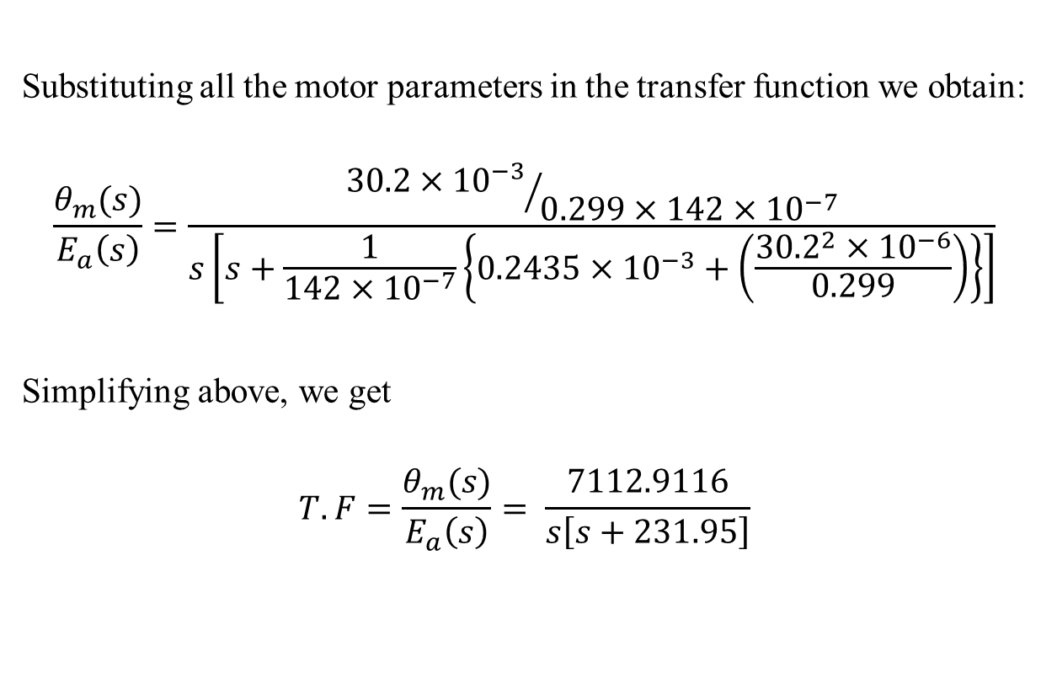
Maxon RE-40 DC Motor Transfer function
Substituting all the motor parameters in the transfer function we obtain:
$$\frac{θ_{m}(s)}{E_{a}\left(s\right)}=\frac{{30.2×{10}^{−3}}/{0.299×142×{10}^{−7}}}{s\left[s+\frac{1}{142×{10}^{−7}}\left\{0.2435×{10}^{−3}+\left(\frac{{30.2}^{2}×{10}^{−6}}{0.299}\right)\right\}\right]}$$
Simplifying above, we get
$$T.F=\frac{θ_{m}(s)}{E_{a}\left(s\right)}= \frac{7112.9116}{s\left[s+231.95\right]}$$

Slide 15
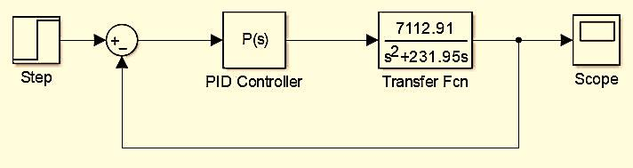
Design of a P Controller for DC Motor
Fig.3 Simulink model for P controller of DC Motor
Proportional gain $K_{P}=$1.

Slide 16
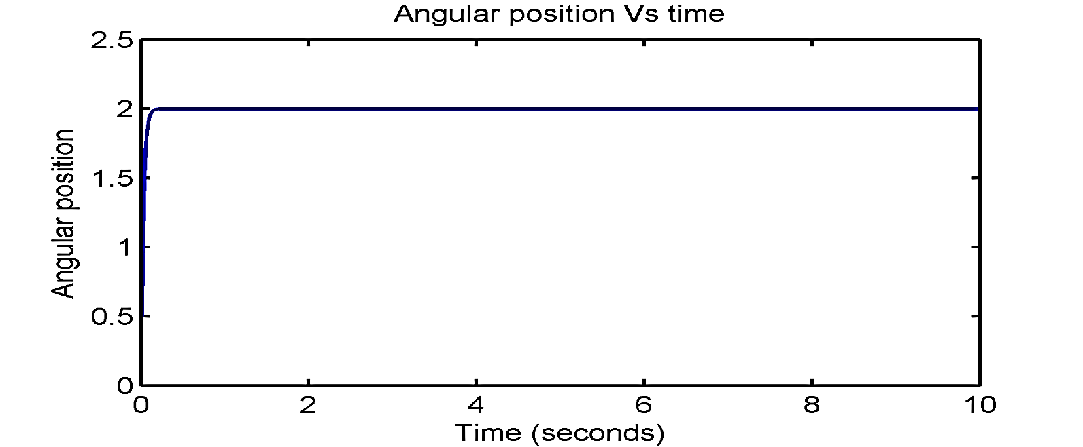
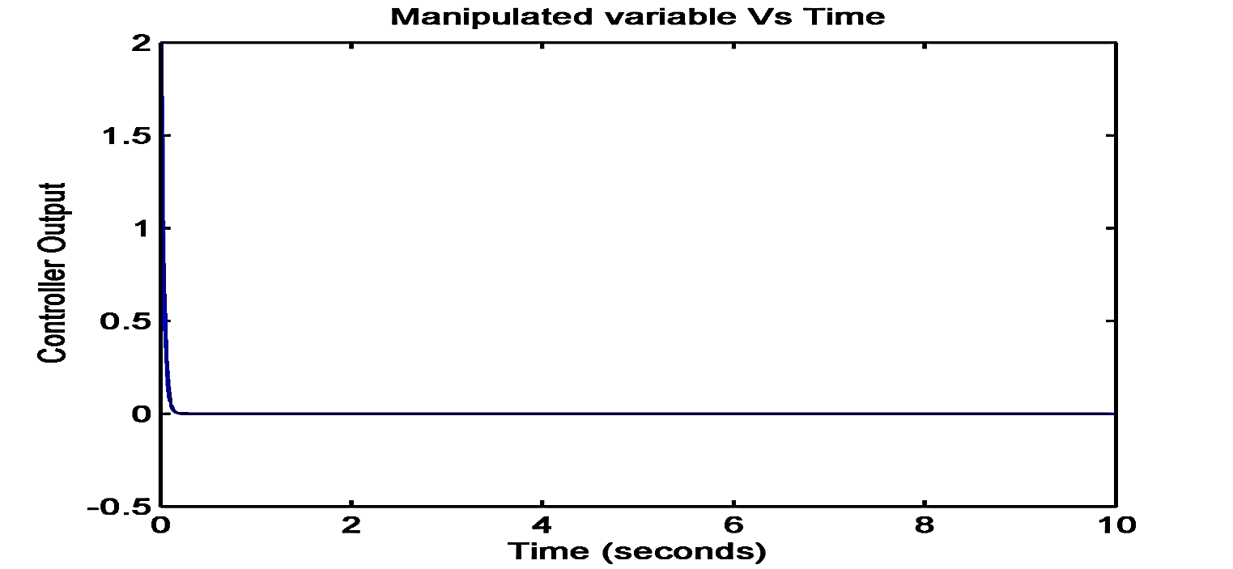
Simulation Results

Slide 17


An Asymmetric Cable-Driven Mechanism for Force Control of Exoskeleton Systems, Yeongtae Jung, Mechatronics, 2016
A spring-actuator type cable driven mechanism is proposed for an accurate force control of an exoskeleton system including external disturbances and modeling uncertainities.
ESCON,
70/10, Servo-controller
Maxon
EC-4pole Motor
Exoskeleton
system
Sensors
$$θ_{D_measured}$$
Controller
$$θ_{D_set point}$$
Fig.4 Block diagram for force control of an exoskeleton system

Slide 18
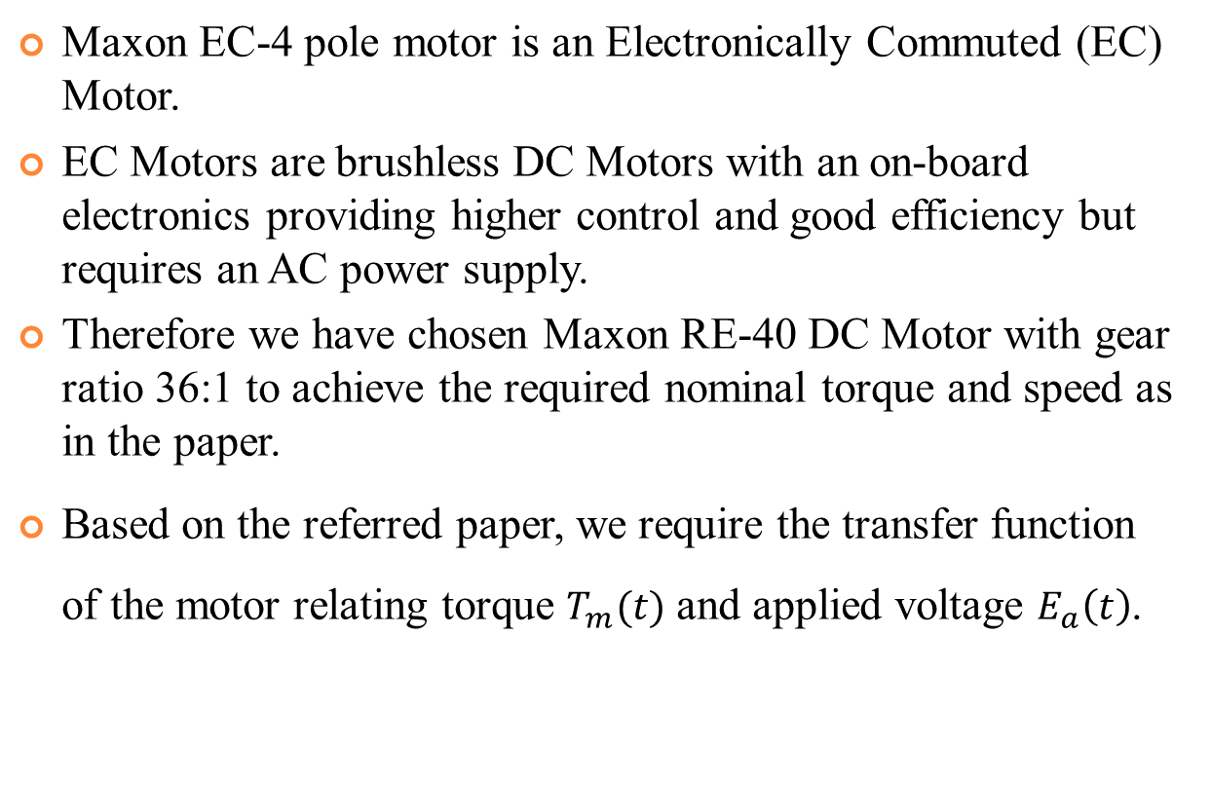
Selection Of Motors
Maxon EC-4 pole motor is an Electronically Commuted (EC) Motor.
EC Motors are brushless DC Motors with an on-board electronics providing higher control and good efficiency but requires an AC power supply.
Therefore we have chosen Maxon RE-40 DC Motor with gear ratio 36:1 to achieve the required nominal torque and speed as in the paper.
Based on the referred paper, we require the transfer function of the motor relating torque $T_{m}(t)$ and applied voltage $E_{a}\left(t\right)$.

Slide 19
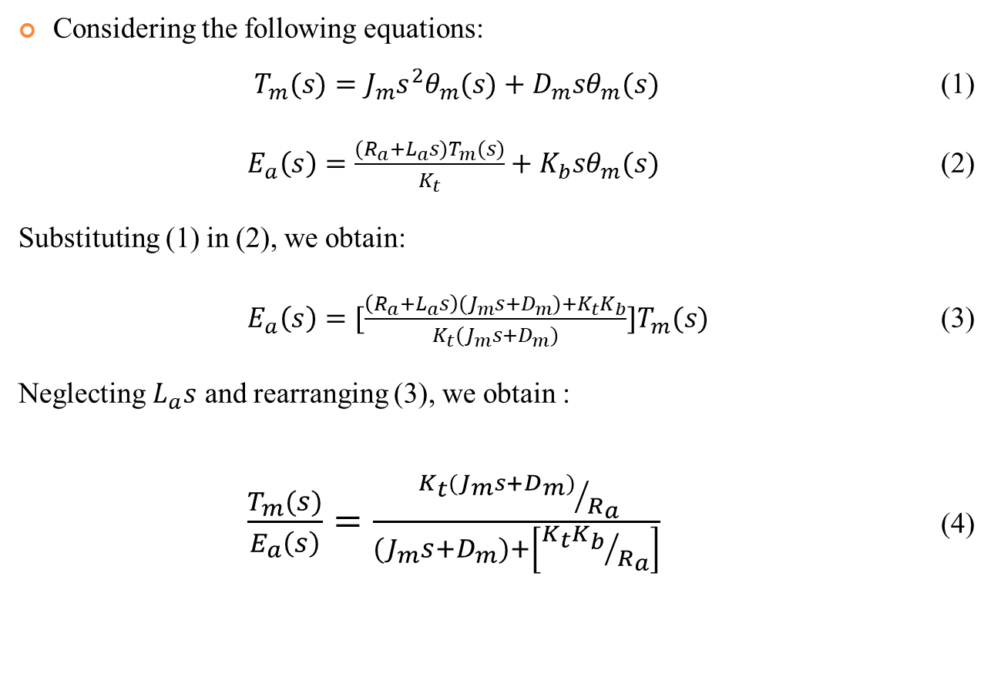
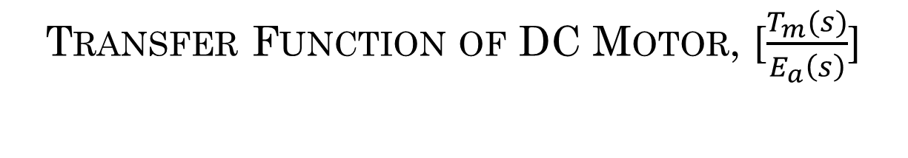
Transfer Function of DC Motor, [$\frac{T_{m}(s)}{E_{a}\left(s\right)}$]
Considering the following equations:
$T_{m}(s)=J_{m}s^{2}θ_{m}(s)+D_{m}sθ_{m}(s)$ (1)
$E_{a}\left(s\right)=\frac{(R_{a}+L_{a}s)T_{m}(s)}{K_{t}}+K_{b}sθ_{m}(s)$ (2)
Substituting (1) in (2), we obtain:
$E_{a}\left(s\right)=[\frac{\left(R_{a}+L_{a}s\right){(J}_{m}s+D_{m})+K_{t}K_{b}}{K_{t}(J_{m}s+D_{m})}]T_{m}(s)$ (3)
Neglecting $L_{a}s$ and rearranging (3), we obtain :
$\frac{T_{m}(s)}{E_{a}\left(s\right)}=\frac{ {K_{t}(J_{m}s+D_{m})}/{R_{a}}}{{(J}_{m}s+D_{m})+\left[{K_{t}K_{b}}/{R_{a}}\right]}$ (4)

Slide 20
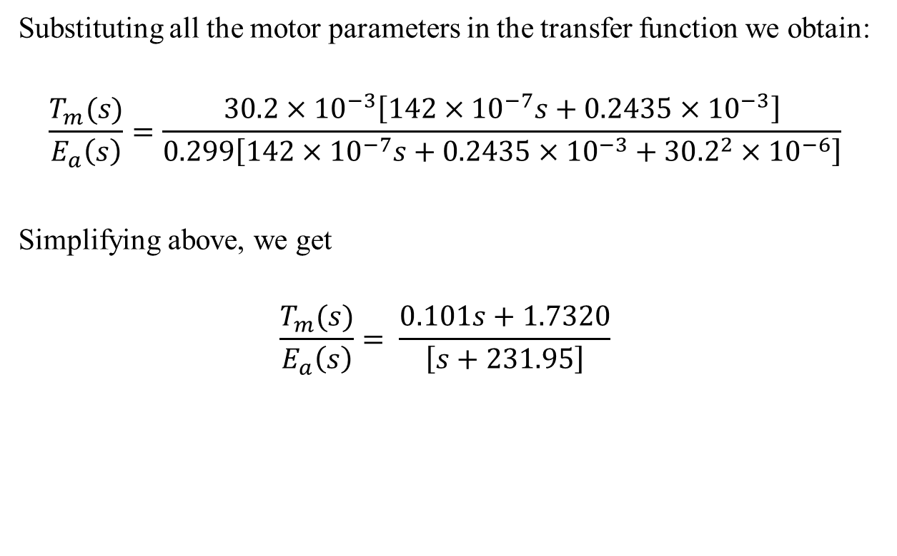
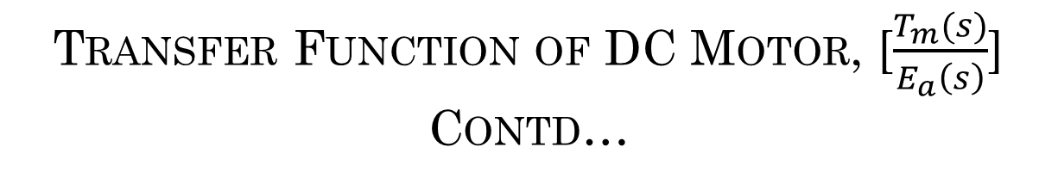
Transfer Function of DC Motor, [$\frac{T_{m}(s)}{E_{a}\left(s\right)}$] Contd…
Substituting all the motor parameters in the transfer function we obtain:
$$\frac{T_{m}(s)}{E_{a}\left(s\right)}=\frac{30.2×{10}^{−3}\left[142×{10}^{−7}s+0.2435×{10}^{−3}\right]}{0.299\left[142×{10}^{−7}s+0.2435×{10}^{−3}+{30.2}^{2}×{10}^{−6}\right]}$$
Simplifying above, we get
$$\frac{T_{m}(s)}{E_{a}\left(s\right)}= \frac{0.101s+1.7320}{\left[s+231.95\right]}$$

Slide 21
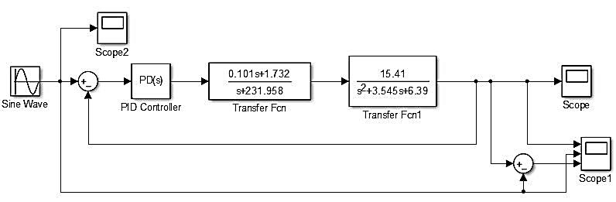

Controller Design for Exoskeleton System
The transfer function of the exoskeleton system is given in the paper are as follows,
$$\frac{θ_{D}(s)}{T_{m}(s)}= \frac{15.41}{\left[s^{2}+3.545s+6.39\right]}$$
Fig. 5 Simulink model for control of exoskeleton system

Slide 22
Future Work and Reference
Modeling of exoskeleton.
Development of advanced control algorithm.
References:
Yeongtae Jung, Joonbum Bae, “An asymmetric cable-driven mechanism for force control of exoskeleton systems”, Mechatronics, 40 (2016), 41-50.
Sahoo, Shubhashisa et al. “Design and development of a heading angle controller for an unmanned ground vehicle.” International Journal of Automotive Technology, 16 (2015), 27-37.
https://www.maxongroup.com/maxon/view/content/index
https://www.tqgroup.com/filedownloads/files/products/robodrive/data-sheets/en/DRVA_DB_Servo Kits_ILM_EN_Rev408_Web.pdf

Slide 23
THANK YOU

